Slide 1
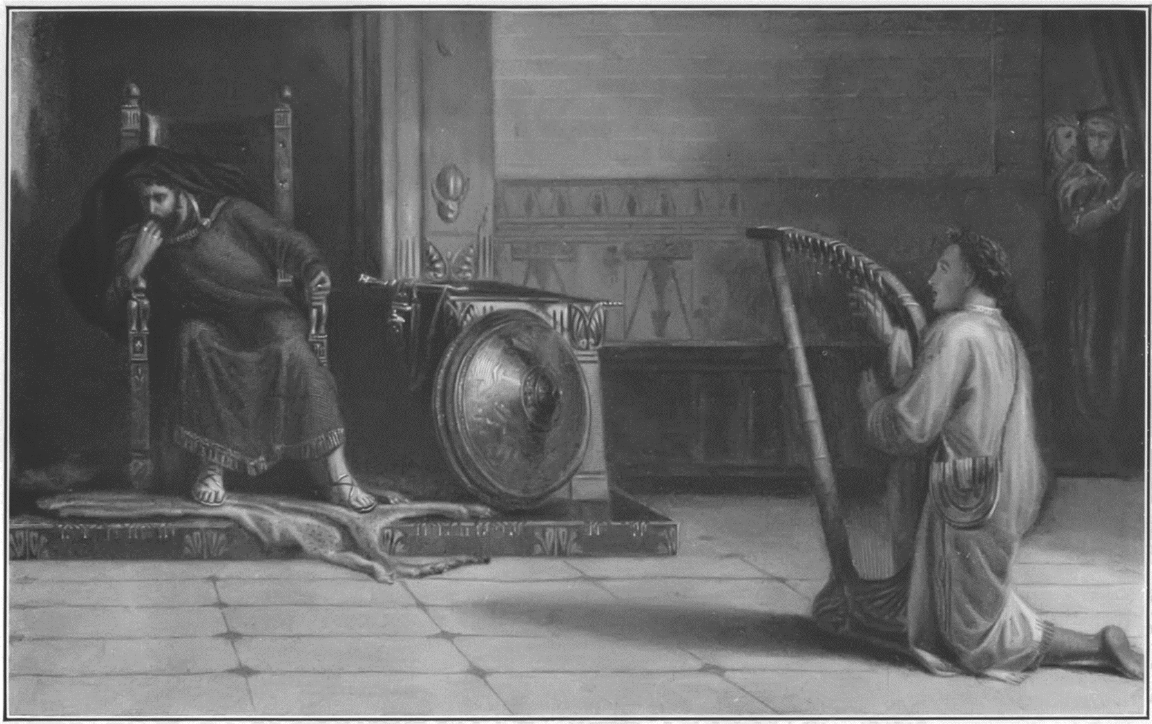
PERSECUTION
“ESCAPE!”
1 Samuel 19:1-17

Slide 2
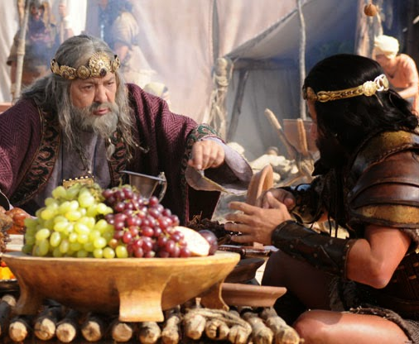
Saul’s fifth run at murdering David.
What WAS in Saul’s heart is now in his mouth!
Matthew 12:34 O generation of vipers, how can ye, being evil, speak good things? for out of the abundance of the heart the mouth speaketh.
Luke 6:45b …and an evil man out of the evil treasure of his heart bringeth forth that which is evil: for of the abundance of the heart his mouth speaketh.
Saul conscripts his servants and his OWN SON to kill David.

Slide 3
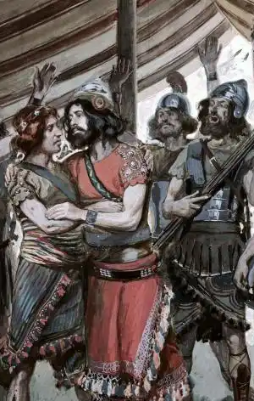
Jonathan’s warning to David.
Jon loved who David was and what his heart was for God!
This is wisdom! Delight in those that God is with (those that are WITH God!)
Key for men: You need healthy and loving male relationships.
KEY: Don’t let the devil twist your need for healthy male companionship into a lie that our world is loving and pushing.

Slide 4
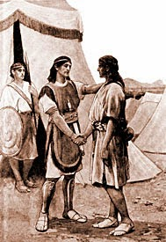
Stand up for your friends.
1 Samuel 18:3-4 Then Jonathan and David made a covenant, because he loved him as his own soul. 4 And Jonathan stripped himself of the robe that was upon him, and gave it to David, and his garments, even to his sword, and to his bow, and to his girdle.

Slide 5
Jonathan’s defense of David.
Speak good of your friends.
Defend them to others.
2 Timothy 4:2 Preach the word; be instant in season, out of season; reprove, rebuke, exhort with all longsuffering and doctrine.
“The only thing necessary for the triumph of evil is for good men to do nothing.” Edmund Burke

Slide 6
Proverbs 17:17 A friend loveth at all times, and a brother is born for adversity.
Ecclesiastes 4:9-10 9 Two are better than one; because they have a good reward for their labour. 10 For if they fall, the one will lift up his fellow: but woe to him that is alone when he falleth; for he hath not another to help him up.
Romans 12:9 Let love be without dissimulation. Abhor that which is evil; cleave to that which is good.

Slide 7
1 Peter 1:22 Seeing ye have purified your souls in obeying the truth through the Spirit unto unfeigned love of the brethren, see that ye love one another with a pure heart fervently:
1 Peter 4:8 And above all things have fervent charity among yourselves: for charity shall cover the multitude of sins.

Slide 8
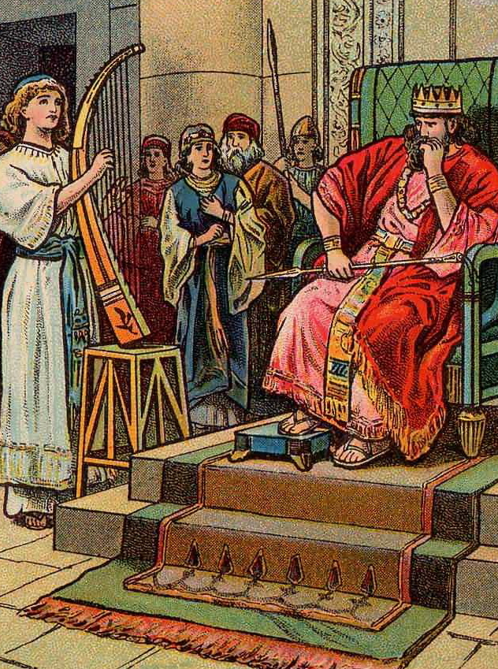
Saul’s empty promise.
What past times?
1 Samuel 16:21-22 And David came to Saul, and stood before him: and he loved him greatly; and he became his armourbearer. 22 And Saul sent to Jesse, saying, Let David, I pray thee, stand before me; for he hath found favour in my sight.
Saul’s problem?
James 1:8 A double minded man is unstable in all his ways.

Slide 9
John 8:44 Ye are of your father the devil, and the lusts of your father ye will do. He was a murderer from the beginning, and abode not in the truth, because there is no truth in him. When he speaketh a lie, he speaketh of his own: for he is a liar, and the father of it.

Slide 10
1 Samuel 18:10-11 And it came to pass on the morrow, that the evil spirit from God came upon Saul, and he prophesied in the midst of the house: and David played with his hand, as at other times: and there was a javelin in Saul's hand. 11 And Saul cast the javelin; for he said, I will smite David even to the wall with it. And David avoided out of his presence twice.

Slide 11
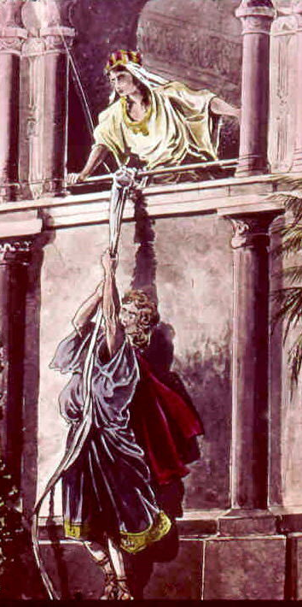
Michal’s defense of David.
It’s a stake out for a hit job.
Messenger=“angel” or “ambassador”

Slide 12
2 Corinthians 12:7 And lest I should be exalted above measure through the abundance of the revelations, there was given to me a thorn in the flesh, the messenger of Satan to buffet me, lest I should be exalted above measure.

Slide 13
Michal’s defense of David.
Why does God allow His people to be buffeted by the enemy?
  We need it, so God uses it. It keeps us humble and dependent on God.
  God shows up the devil (the god of this world! 2Cor 4:4) Example: Job 1

Slide 14
Michal’s defense of David.
Michal engineers David’s escape!
Three examples of escaping through a window:
  Two spies escaping from Jericho. Jo 2:1, 15
  David escaping Saul. 1 Sam 19:12
  Paul escaping Damascus. 2 Cor 11:32-33
  There are FOUR if you count Acts 20:9
Acts 20:9 And there sat in a window a certain young man named Eutychus, being fallen into a deep sleep: and as Paul was long preaching, he sunk down with sleep, and fell down from the third loft, and was taken up dead.

Slide 15
1 Samuel 18:29 And Saul was yet the more afraid of David; and Saul became David's enemy continually.
1 Peter 5:8 Be sober, be vigilant; because your adversary the devil, as a roaring lion, walketh about, seeking whom he may devour:

Slide 16
Michal’s defense of David.
Michal lied.
Four insights into Michal’s character.
  Deception. 1 Sam 19:13,16-17
  Lying to the messengers. 1 Sam 19:14
  Lying to Saul about David. 1 Sam 19:17
  Despising her husband in her heart.
  2 Sam 6:16-23; 1Chr 15:29
Her punishment for despising David? Barrenness. 2 Sam 6:23

Slide 17
Picture: Pride, envy and jealousy break up families.

Slide 18
Proverbs 15:18 A wrathful man stirreth up strife: but he that is slow to anger appeaseth strife.
Luke 11:17 But he, knowing their thoughts, said unto them, Every kingdom divided against itself is brought to desolation; and a house divided against a house falleth.
1 Corinthians 3:3 For ye are yet carnal: for whereas there is among you envying, and strife, and divisions, are ye not carnal, and walk as men?

Slide 19
PERSECUTION
“ESCAPE!”
1 Samuel 19:1-17

